Slide 1

The Patient Perspective: Living with Delayed Nausea
  Abigail Johnston, JD

Slide 2
Personal Experiences with CINV, particularly T-DXd
Initial diagnosis of MBC in 2017 at 38 with a strong history of vomiting, exacerbated by migraines, fertility treatment and pregnancies
Received Adriamyacin, Cytoxan (2017) and Taxotere (2022) before T-DxD (2024-2025), experienced intense nausea and vomiting that was controlled with various anti-emetics. Also hospitalized with intractable vomiting while on Piqray/alpelisib in 2020.
Had previously been prescribed a variety of anti-emetics, with varying efficacy on different lines of treatment
Tried and adjusted a 4 medication cocktail while receiving Enhertu/T-DxD over 18 months to control the nausea and vomiting, but note that different patients are managed differently.
Favorite tool in my toolbox for CINV

Slide 3
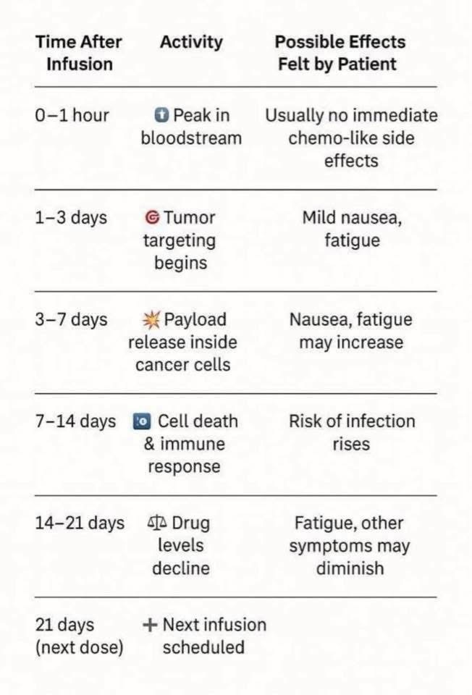
Before Prescribing a new Line of Treatment, particularly one with risk of CINV
Designate someone on your team to assess the potential for a pre-disposition to side effects
Consider utilizing a pharmacist to talk through timing of active ingredients ”peaking” throughout the cycle
When side effects can show up differently throughout a cycle, consider providing patients with a visual of what to expect and perhaps a calendar
Consider suggesting that patients keep a symptom diary for the first few cycles to watch for patterns and so your team will know when to intervene or to check on patients

Slide 4
Treat the Person, not the labs
Labs don’t tell the whole story – many of us are really good at replacing electrolytes and work with integrative and complimentary teams to monitor and replenish what we need
Many patients have experienced negative responses when sharing about supplements and other interventions, so stop telling their traditional medicine teams to avoid the potential conflicts, so you don’t know all that they are doing at home.
Just because a patient looks ok, doesn’t mean they are ok – believe patients when they report Grade 3 symptoms even if their lab results are “normal.”
Consider touch points and consider who the patient has developed a rapport with already on your team.
Remember pharmacists have different training and different expertise to offer.
Consider looping in palliative care and providing the questions or key information.
Consider support from PCPs and GI doctors from the beginning of a new line of treatment.
Most crises occur overnight or on the weekend, so have a way for patients to get help without ending up in the ER and communicate this plan from the beginning.

Slide 5
Patients talk to one another and we use the Internet
There are thriving support groups on social media, particularly Facebook, where patients connect with one another about a variety of things – there are support groups specific to each medication prescribed for MBC and these groups are international. Some are moderated well and some are not. There are opportunities for all of you to present to patients directly and we welcome you.
Many non-profits provide peer-led and professional-led support groups; talking through side effects from treatment is a constant discussion. There are opportunities for all of you to present to patients directly and we welcome you in these spaces.
Increasingly, patients are turning to ChatGPT and other AI platforms to get information
Consider how you can engage with patients where they are

Slide 6
Suggestions for ways to Engage with Patients
In the US
Bookmark GRASPCancer.org and sign up for their newsletters, get involved in poster sessions. You can even suggest a “Huddle” on any topic you want to discuss with patients.
Bookmark Metavivor.org and sign up for their newsletter. Under “Get Support,” there is a link for support groups for the newly diagnosed and a map of those of us who are trained as peer to peer leaders and moderate support groups.
Bookmark the MBCAlliance.org and follow their efforts. The website has many individual members who are people living with MBC who highlight their projects and initiatives.
Outside the US
Bookmark the ABCGlobalAlliance.org and follow their efforts.

